Slide 1

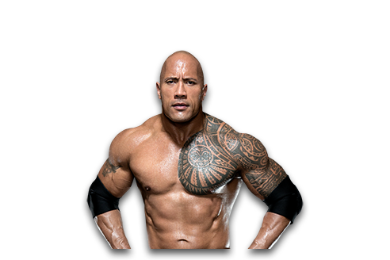

California
CA
A golden state?
Tim, Felix, Lars, Philipp

Slide 2
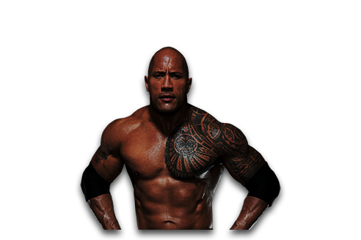
Content
Californian representation
Songs
Movies
California's success
California: A “golden state”?
Mexican border
History of california
Wenometchainsama

Slide 3


Californian representation: Songs

Slide 4
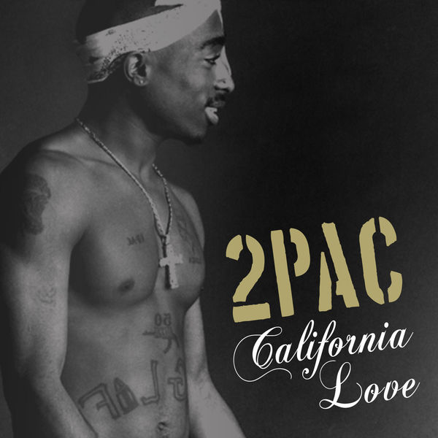
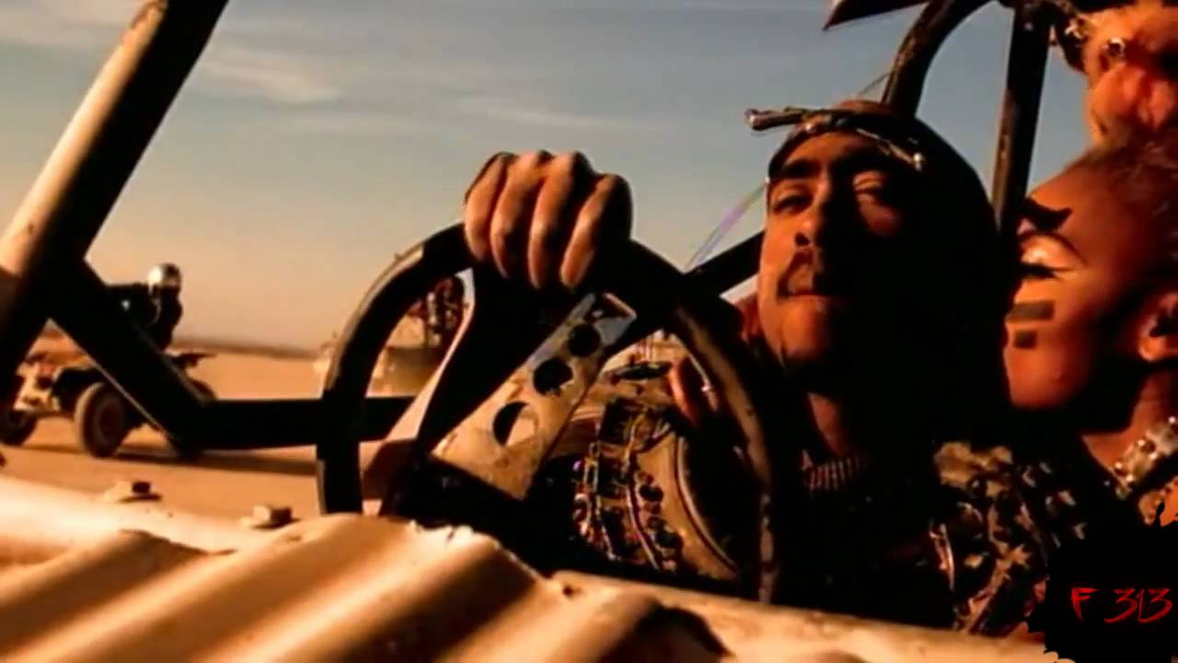

Californian Representation
One of the most famous musicians from California is 2pac (Tupac Shakur)
His second most famous song, „California Love“, has over 400 million streams on Spotify
The song is about his passion for californian parties
In the second part he talks about recording „California dreamin‘“ as soon as he got out of jail
The album was released two weeks after his release

Slide 5
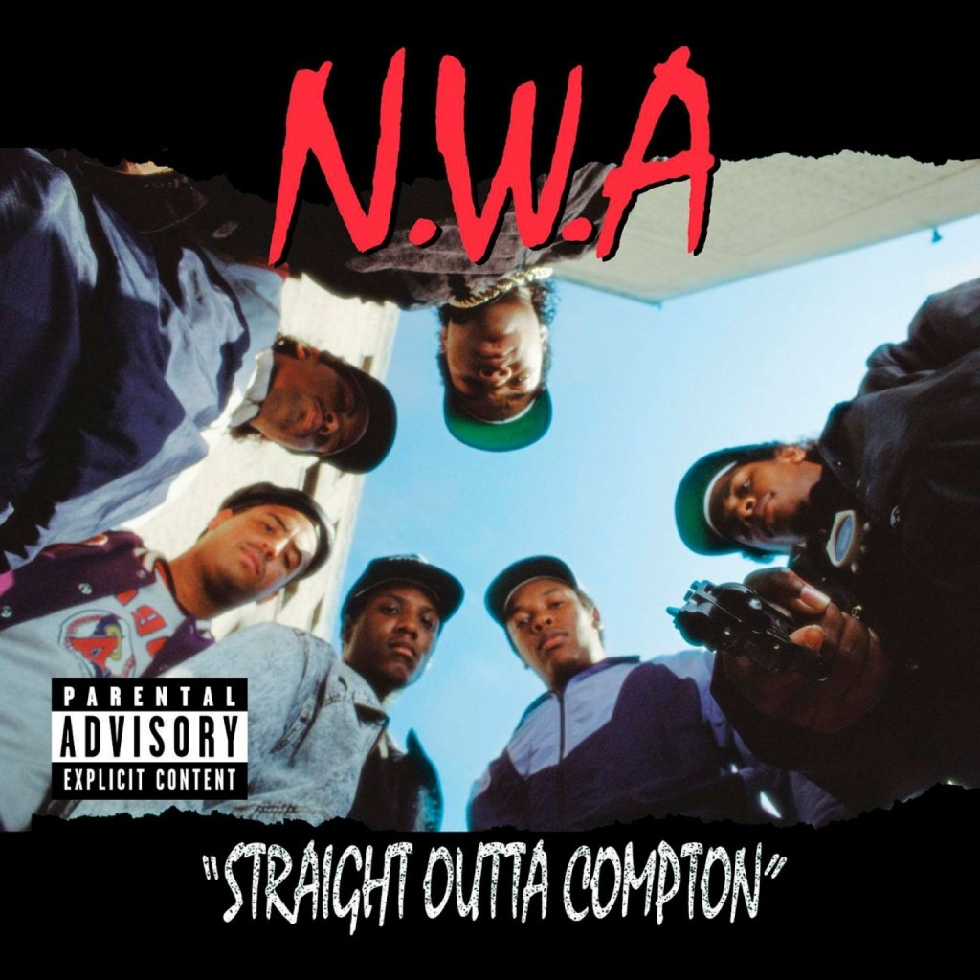

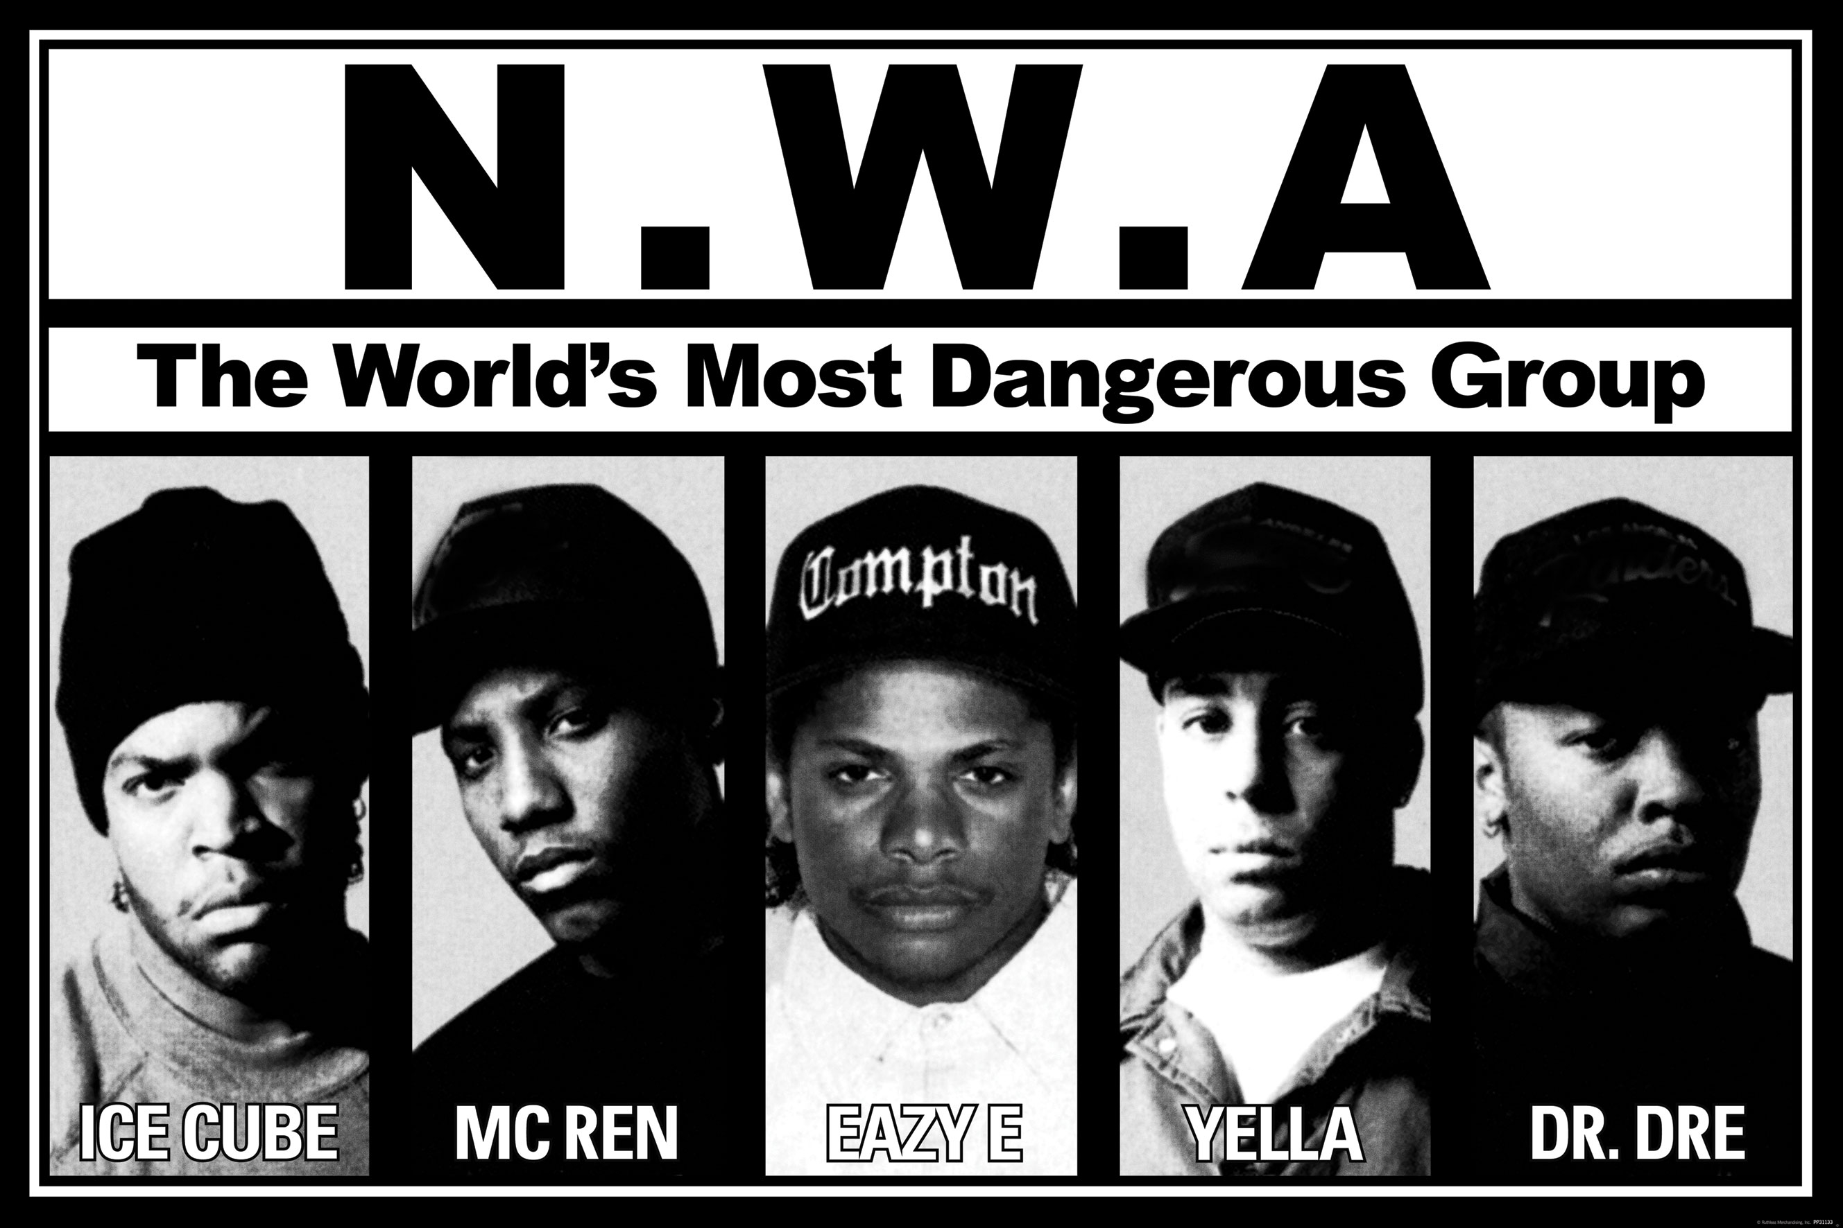
One of the most iconic hip hop group from the 90s is the N.W.A
Some of their most streamed songs are:
Straight Outta Compton
Fuck Tha Police
The second song is about police cruelty in the US
The lyrics caused a minor controversy
The music magazine „RollingStone“ complimented the record in 1999:
Shinéa O’Connor stated that he can see how the lyrics might offend some people
As a private person however, he still isn’t offended by the lyrics
***

Slide 6
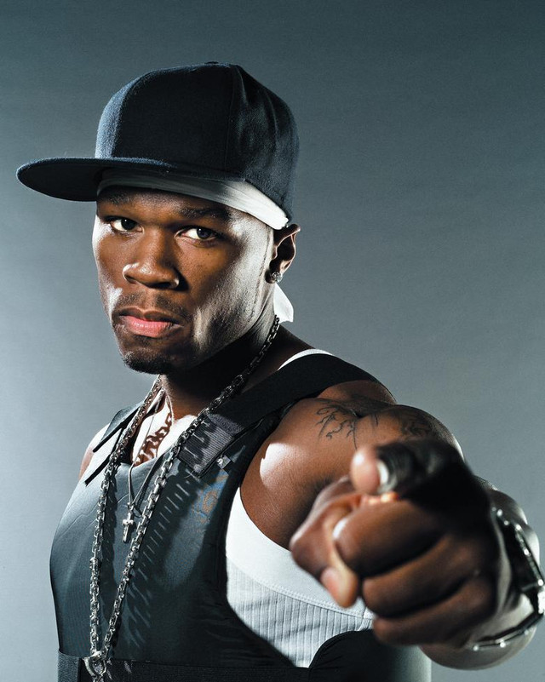

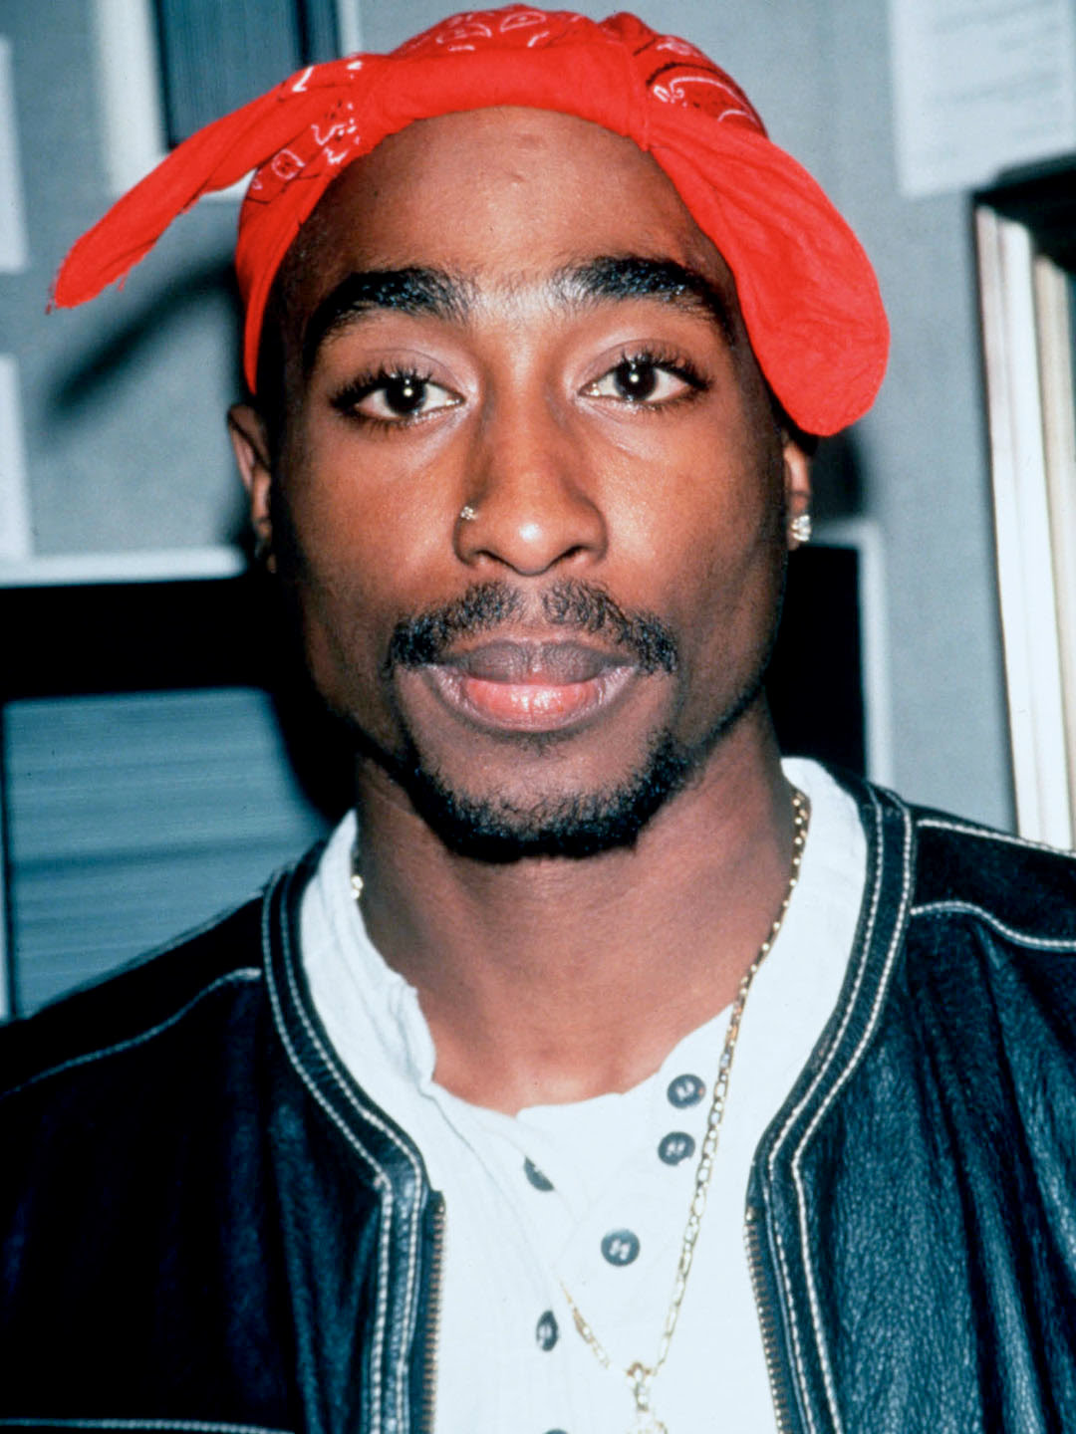
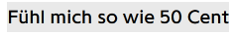
Many hip hop artists from around the world took heavy inspiration from west coast classics, here are some german examples:

Slide 7
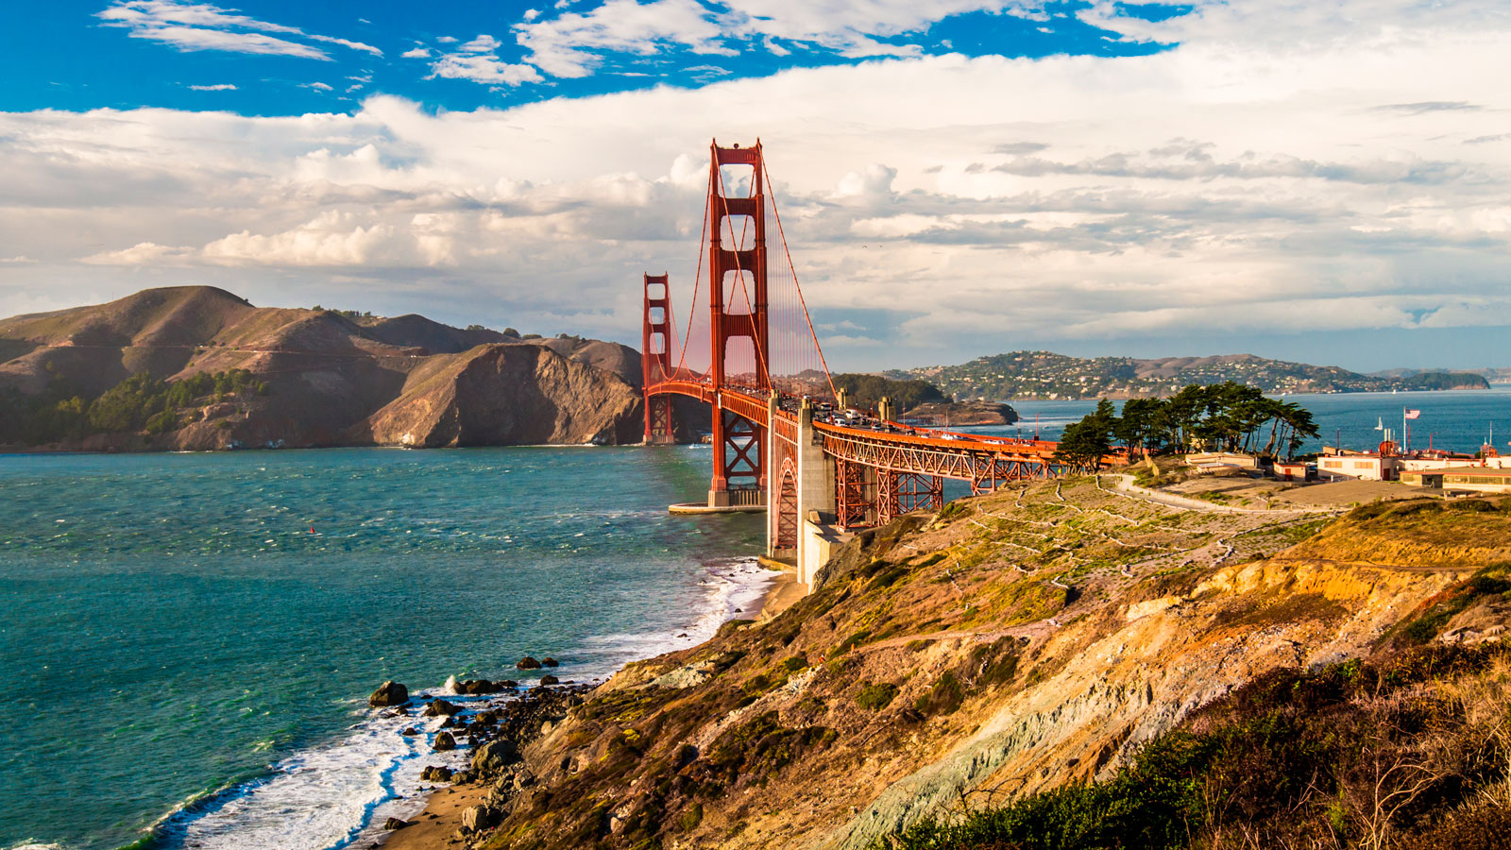
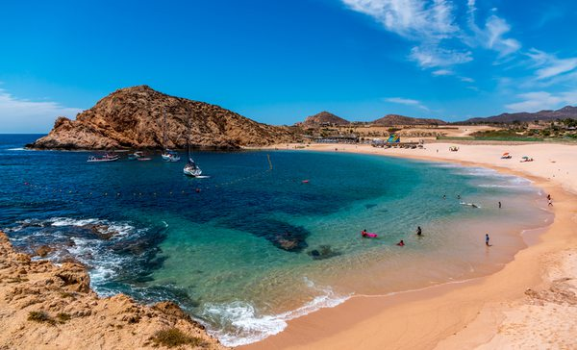

California in Music
There are many songs in which California is represented as a perfect State, where you can live your dream life and everything is perfect.
California Gurls -Katy Perry
“You could travel the world, but nothing comes close to the golden coast”
In this song California is associated with party, beach, beautiful scenery and fun.
Gone to California – Pink
“I'm goin' to California To find my pot of gold” -Bobby Slayton
California is represented as a place where you can reach wealth and richness easily

Slide 8
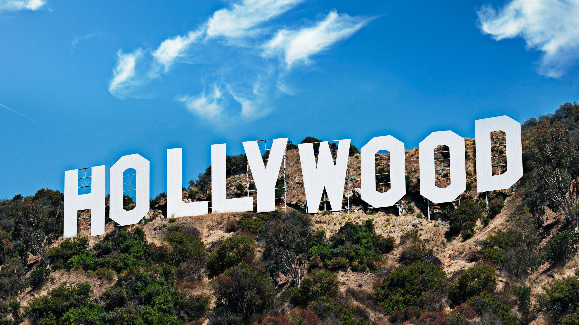
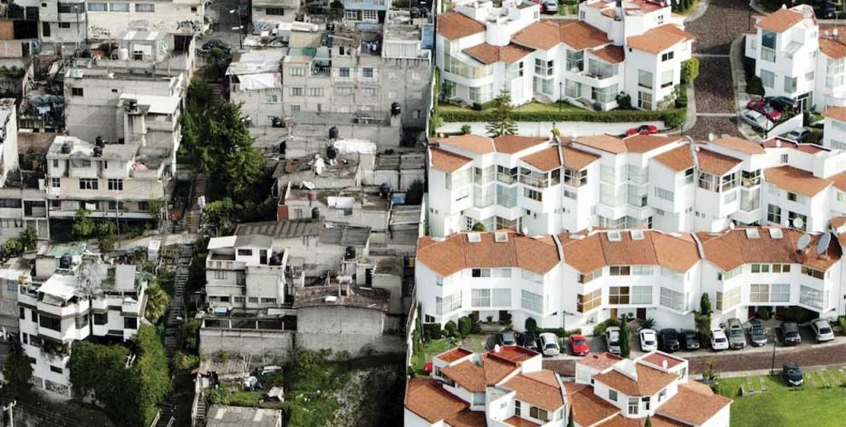
Critical songs about California
Californication- red hot chili peppers
“Pay your surgeon well to pay the spell of aging” (Ironical)
The song is about everything that is wrong with Hollywood.
Everything is fake, everyone is made by plastic surgery. Hollywood is changing the ideals of people.
Hotel California- eagles
In the song “Hotel California” The eagles are critical about the wealth and abundance, in which people in America and particularly in California live.
“She got the Mercedes Benz”
“The pink champagne on ice”
(Criticism about wealth)

Slide 9
Californian representation: Movies

Slide 10
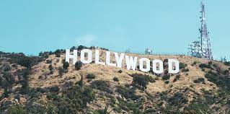
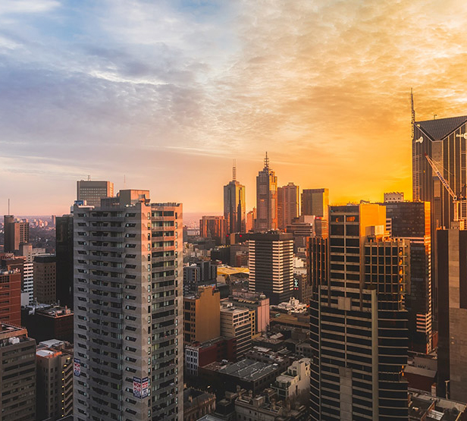
California in Movies
It is always the sunny state with perfect beaches and where everybody just lives a perfect live.
Also California is represented as the state, where all your dreams are possible to reach.
California has strikingly beautiful scenery, exciting cities, and colorful characters.
It has also a rich history that begs to be discovered.

Slide 11

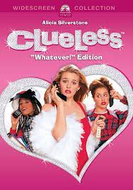
California in Movies
As well as in music there are also critical movies about California
Clueless – this movie satirizes how ultra rich teens in California live their live and don't have to care about anything
It satirizes how these teens are dependent and unintelligent
Rich kids

Slide 12
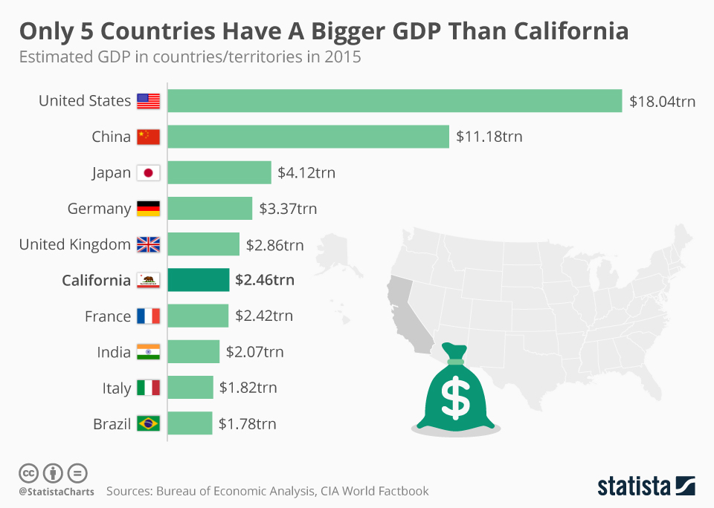
California's success
Success began with gold rush
Many people settled down in cities
Sunny climate, strong economy still attracts millions of people
In the 90’s companies were founded in California: Apple, Google, Netflix, EBay.
People still attracted until today
GDP = Gross Domestic Product (Income of a country or region)

Slide 13
California: A “golden state”?

Slide 14
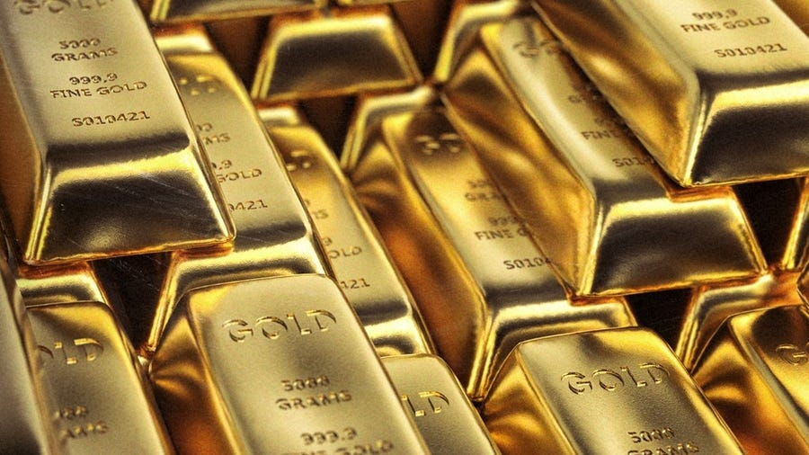
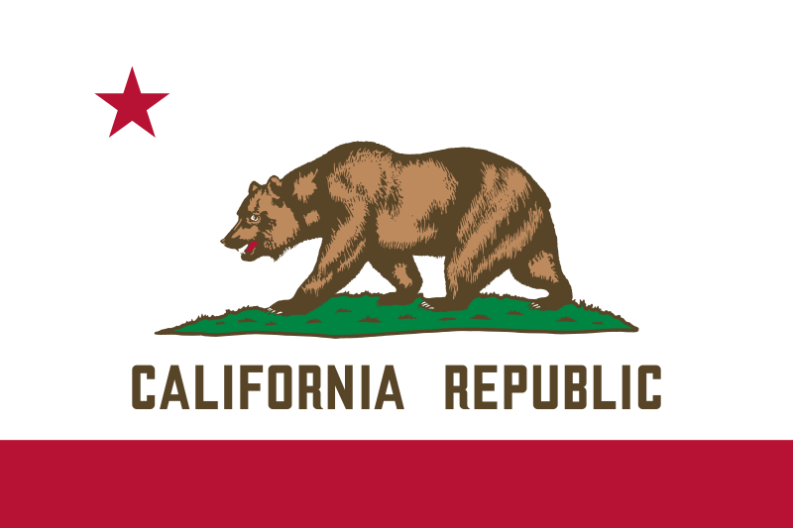
California: A “golden state“?
California can be called the "golden state" because of the actual gold found there. Not only were many large companies founded there, but also the strong economy and the very rich state make the name appropriate.

Slide 15
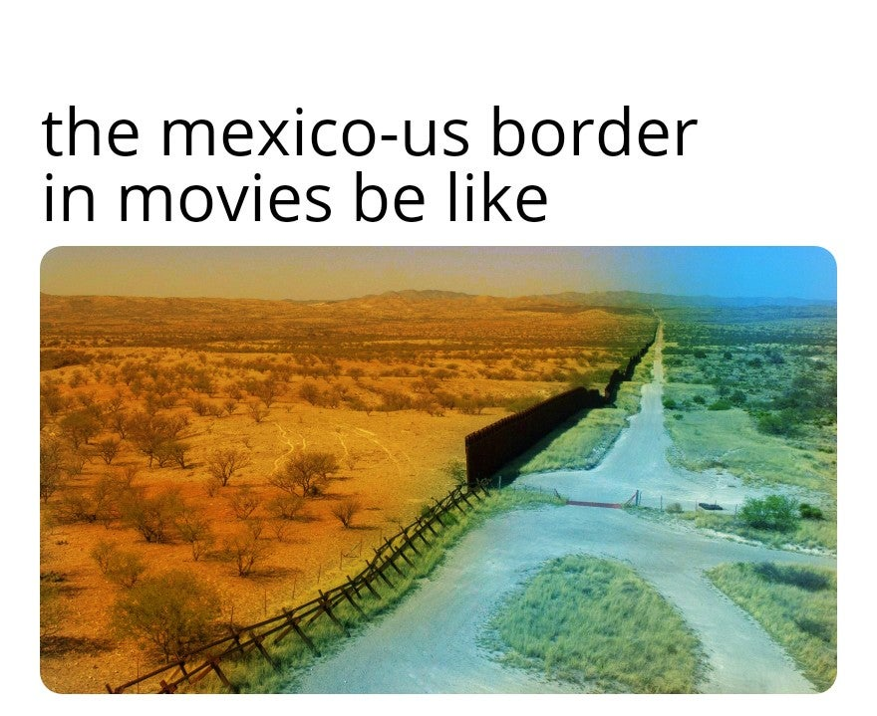
Mexican Border
The border splits habitats of animals
Flooding
Easy to pass with $100 tools
Sending a "keep out" message
People still trying and over 5000 died
Illegal Mexicans do hard jobs no Americans want to do
Hard to travel between countries

Slide 16
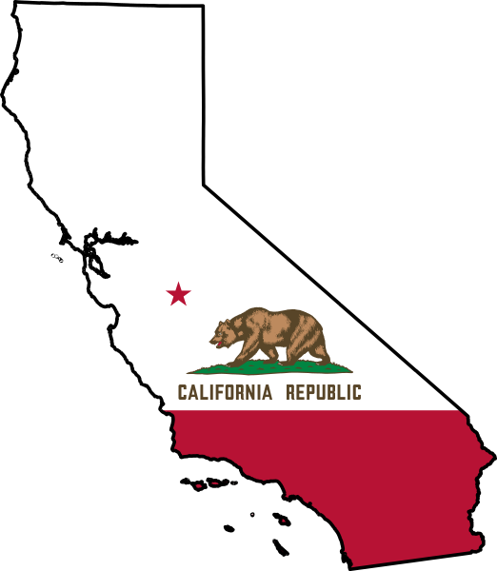
History of California
➔1542 Portuguese explorer landed on the coast of California
➔In 16th/17th centuries European explorers searched for gold in “El Dorade”
➔1990 millions of dollars were spent on starting new web businesses

Slide 17
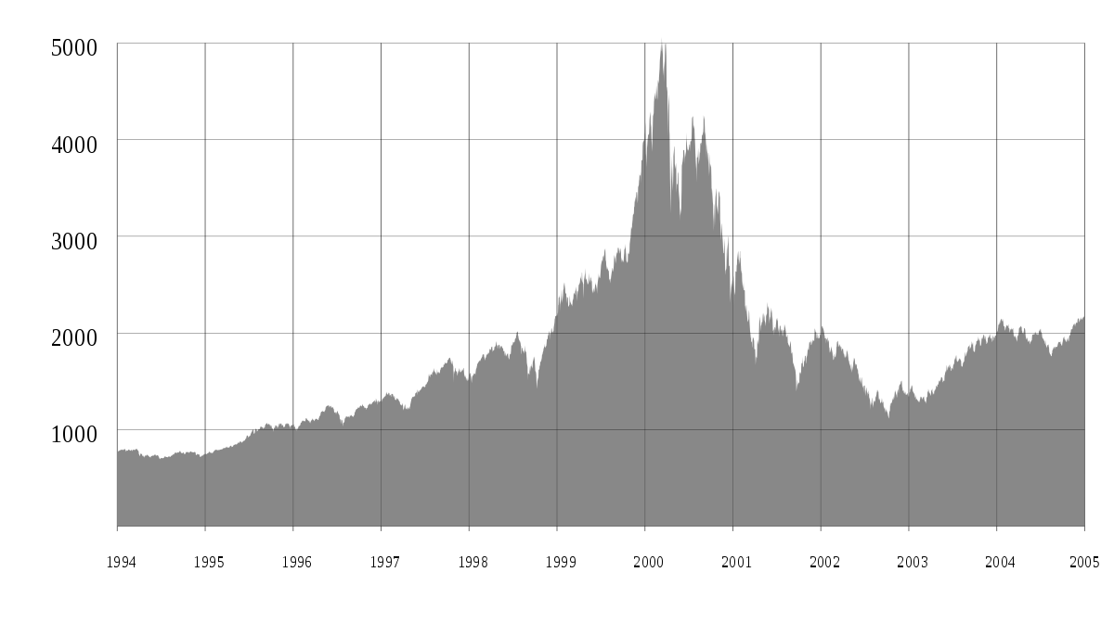
History of California
➔2001 the “dot-com bubble” and millions of dollars were lost
➔2011 Beginning of a drought

Slide 18
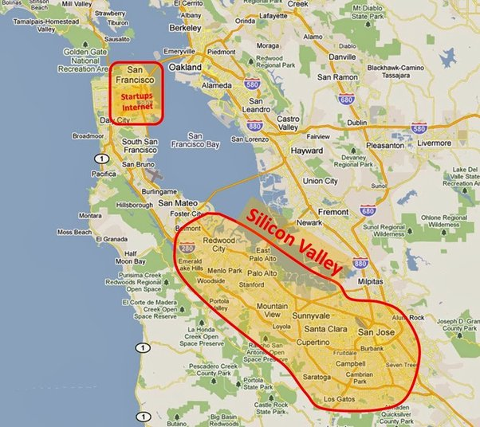
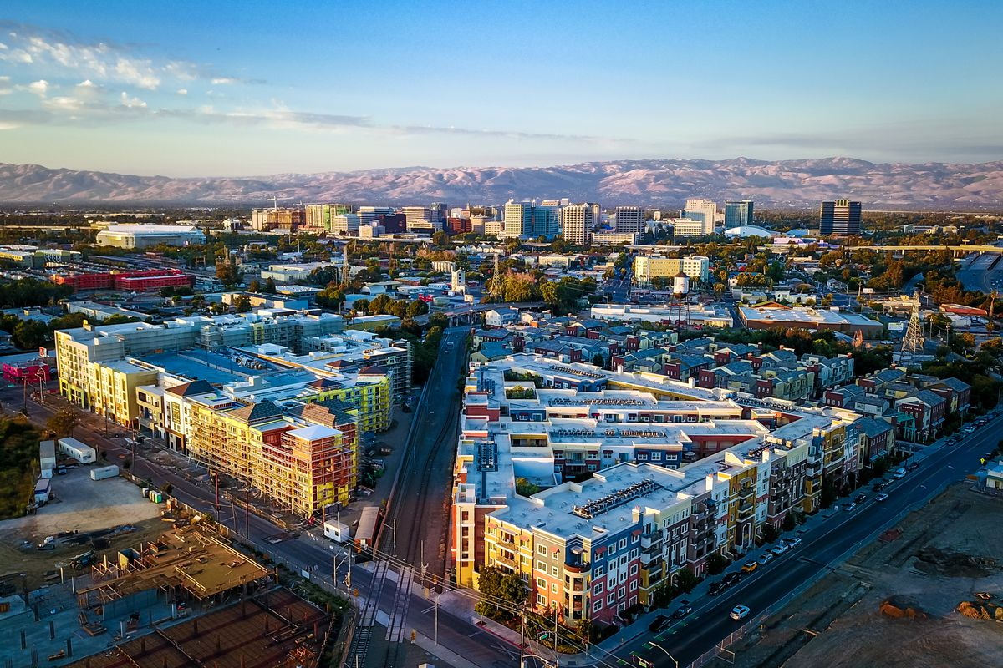
Silicon Valley
Area: 15,000km²
Large number of tech companies
Bears this name from a company
Apple, Google, AMD, Adobe, eBay, Nvidia, Facebook, Tesla
„Silicon Valley“ is often used for the Californian tech industry

Slide 19

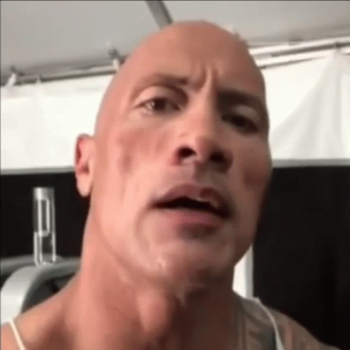
Thank you for listening
FR
FABRIKAM RESIDENCES

Slide 20
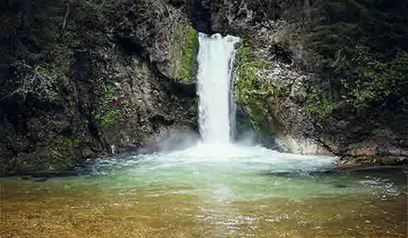

Quellen
https://wordpress.clarku.edu/musc210-hhp/hip-hop-culture-politics-exploring-the-narrative-and-power-of-rap-lyrics/fuck-tha-police-n-w-a/
https://www.youtube.com/watch?v=J7_bMdYfSws
https://www.thoughtco.com/mexico-border-fence-pros-and-cons-1951541
https://www.brookings.edu/blog/order-from-chaos/2020/07/20/the-damage-trumps-wall-causes-in-mexico/
https://www.nationalgeographic.com/environment/article/how-trump-us-mexico-border-wall-could-impact-environment-wildlife-water
https://de.wikipedia.org/wiki/Kalifornien
https://preview.redd.it/m931sb9bi3k61.jpg?auto=webp&s=b6337eafdfe0827a8647ec8dadd08efbe1b9c94e
https://upload.wikimedia.org/wikipedia/commons/thumb/0/01/Flag_of_California.svg/800px-Flag_of_California.svg.png
https://thumbor.forbes.com/thumbor/fit-in/900x510/https://www.forbes.com/advisor/de/wp-content/uploads/2022/05/gold-ingots-2021-08-29-05-54-54-utc-Cropped.jpg
https://open.spotify.com/artist/3q7HBObVc0L8jNeTe5Gofh
https://www.youtube.com/watch?v=yy16KFzM4XU
https://en.wikipedia.org/wiki/R$
https://genius.com
https://au.rollingstone.com/music/music-lists/best-songs-of-all-time-30065/n-w-a-fuck-tha-police-30377/
https://www.rollingstone.com/music/music-features/nwa-fuck-tha-police-protest-song-1010355/
https://theculturetrip.com/north-america/usa/california/articles/10-films-that-capture-californias-soul/

Slide 21
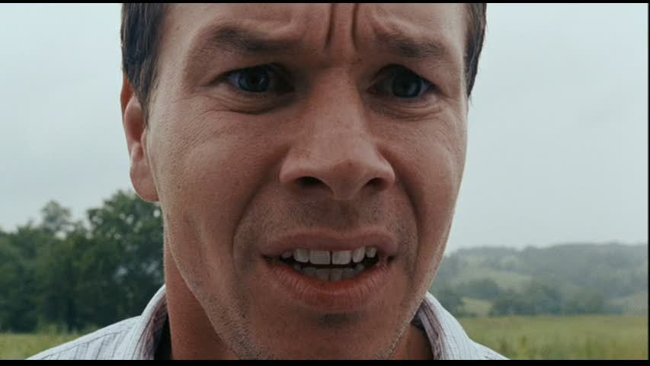




Do you have any questions?????????
FR
FABRIKAM RESIDENCES

